Slide 1
Scheduling System Design Model Taylor Mathews Stephen George Michael Deluca Chase Laprime

Slide 2
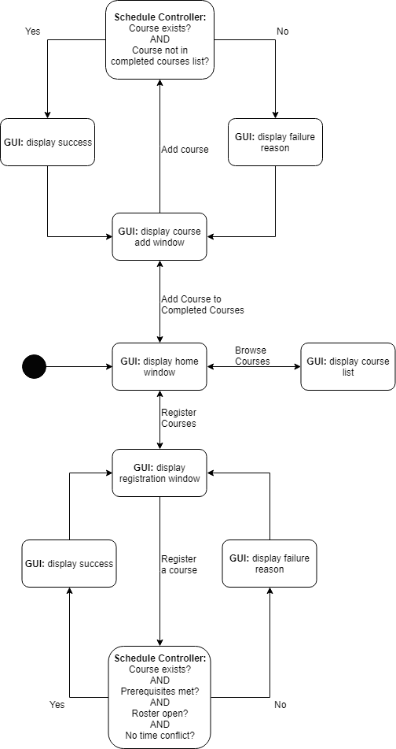
State Diagram

Slide 3
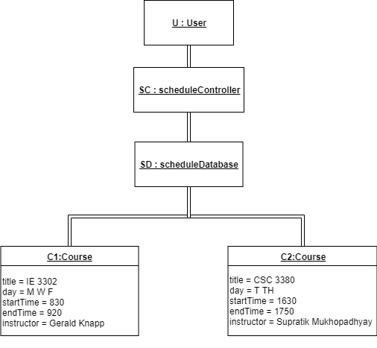
Object Diagram

Slide 4
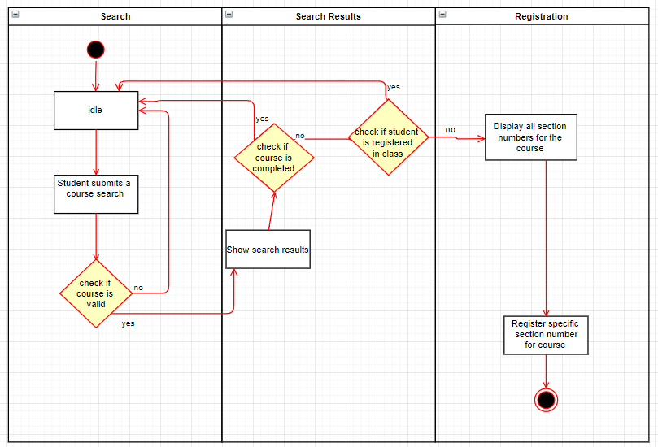
Activity Diagram

Slide 5
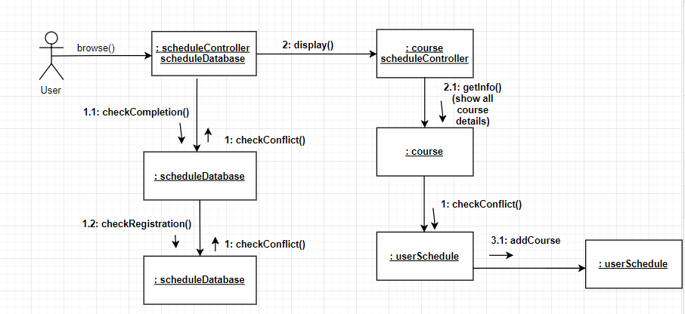
Collaboration Diagram

Slide 6
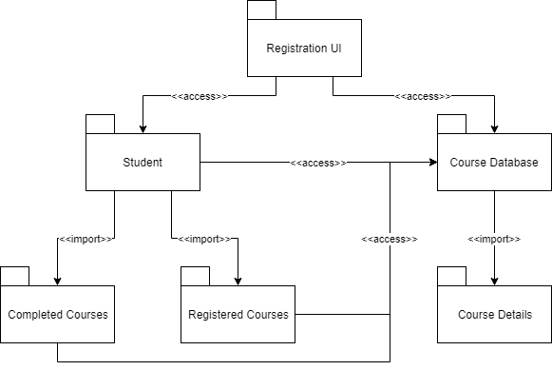
Package Diagram

Slide 7
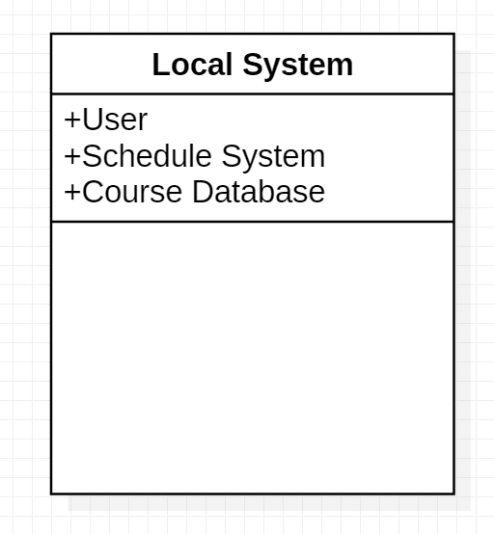
Deployment Diagram

